Slide 1
3. Data Exploration

Slide 2
Variable Summary – Understanding Distribution and Missing Data
Explore each variable’s counts, basic statistics and distributions. [PROC SUMMARY, PROC FREQ]
QC and fill in missing data.
Note each variable’s characteristics and possible deviations from Normal distributions.
Counts
# of Records
# Missing
Basic Stats
Sum, Average, Standard Deviation
Min, Max
Distributions
Percentiles (1%, 5%, 25%(Q1), 50%(Median), 75%(Q2), 90%, 95%, 99%)
Skewness, Kurtosis
Expect minimal missing data. Fill them with zeroes or default values or Null values as applicable
Explore each distribution and understand its skewness – helps in planning transformations

Slide 3
Compare Spends vs. Promotional Activities – HCP Channels
Observe if Total Spends for each HCP channel has relevant Activity counts
Important to do comparison of Monthly Spend vs Activity Trends for each promotion –
This may be a difficult task as monthly “actual” spends are not readily available for HCP channels – Multiple interactions with Solved / Team Frontiers will be needed.

Slide 4
Compare Spends vs. Promotional Activities – HCC Channels
Check if Total Media Spends from Media Calendar for each HCC channel has relevant Activity counts

Slide 5
Compare Spends vs. Promotional Activities – HCC Channels
Check if Monthly Media Spends from Media Calendar for each HCC channel has relevant Activity counts
Media Calendar is obtained from Merck Media Team

Slide 6
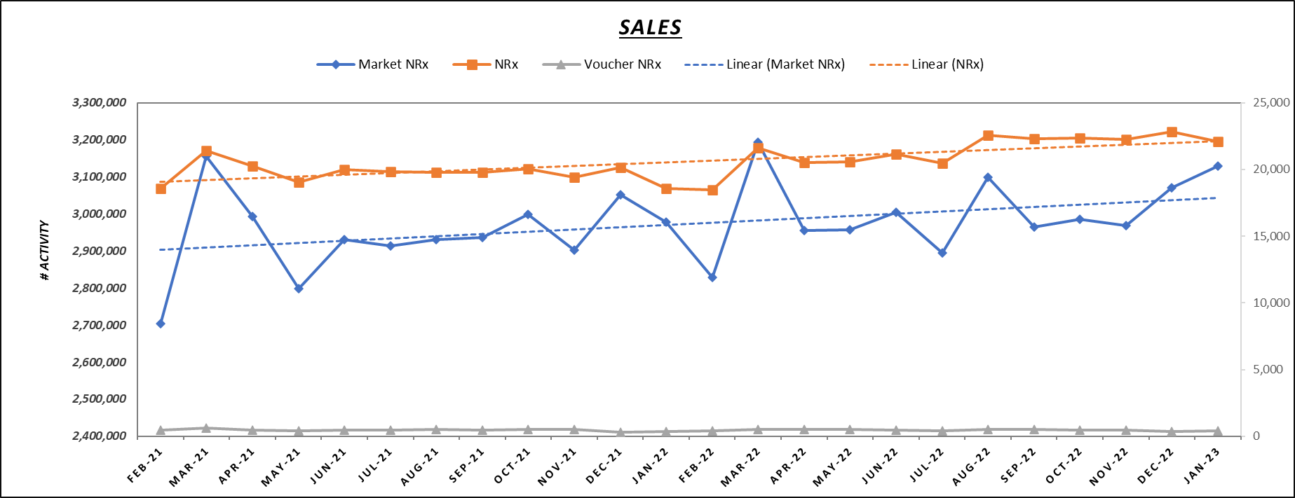
Explore Trends – Sales Trends
Observe Growth Trends, Seasonality, Market share changes, Data Capture methods - NRx, TRx

Slide 7
Explore Trends – Sales Trends
Consider model variables to address the patterns
Growth Trends - Continuous time variable (linear, quadratic, cubic)
Seasonality – 12-Month Lags or Time Indicators for Seasonal Months
Data Capture Patterns – M1 (4 weeks) / M2(4 weeks) / M3 (5 weeks) – Indicator with a value of 1 for 3rd month with 5 weeks of data)
Complex trends – Time Indicators for each month – this has multiple advantages for modeling and is more generic and flexible to accommodate multiple market factors
Lagged Variables for Carryover – One time period Lag (most common), Three month Lag (capture 4/4/5 trends and carryover), Seasonal lag (i.e., 12 month lag) etc.

Slide 8
Explore Trends – Promotional Trends
Compare Trends of Each promotion against Sales and make notes of any pattern (and/or lack there of)
Compare HCP Promotions in terms of Delivery & Engagements (Opens, Clicks)
Compare HCC Promotions - Impressions, Clicks - focus on metric that is commonly used in models
For each Promotion – Compare the current trend with the trend used in a prior analysis – often this method captures various data issues.

Slide 9
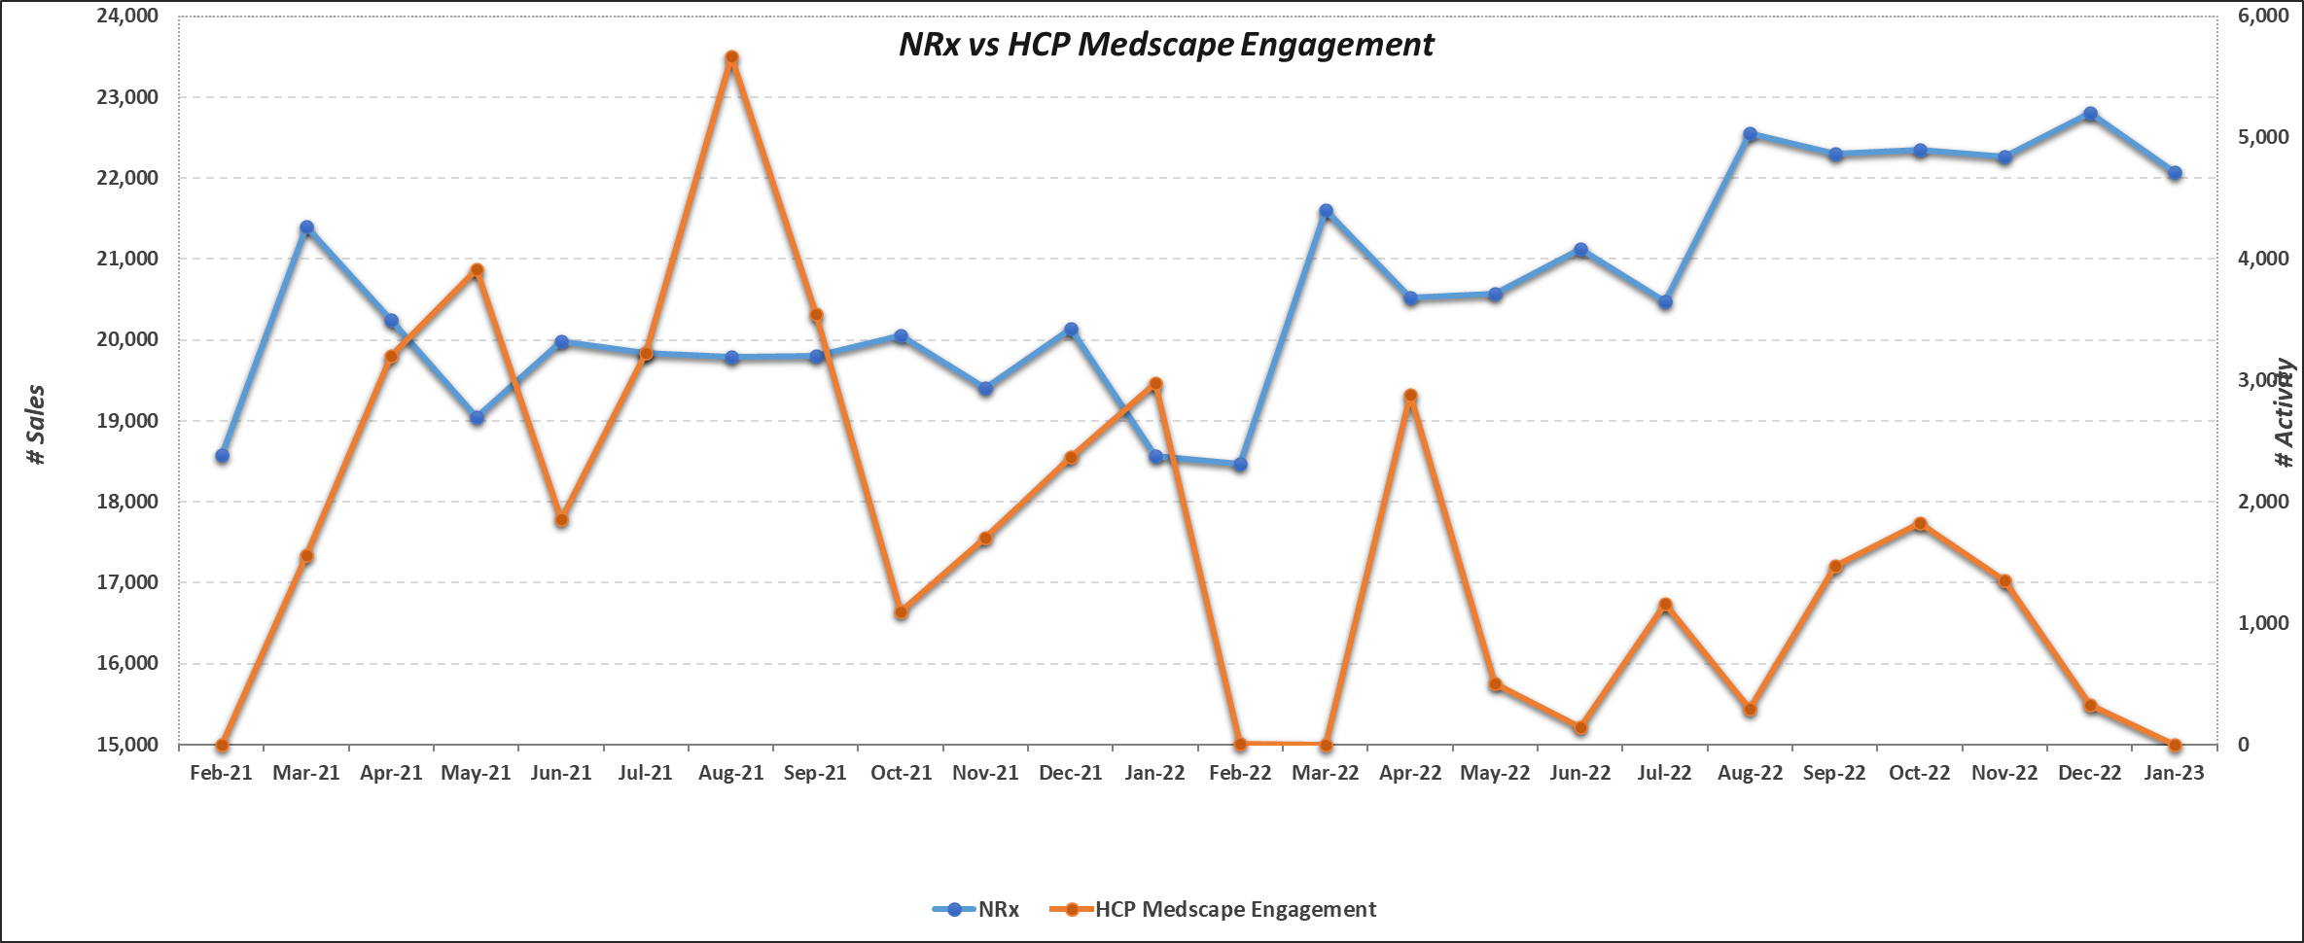
Explore Trends – HCP Medscape Engagement vs Sales

Slide 10
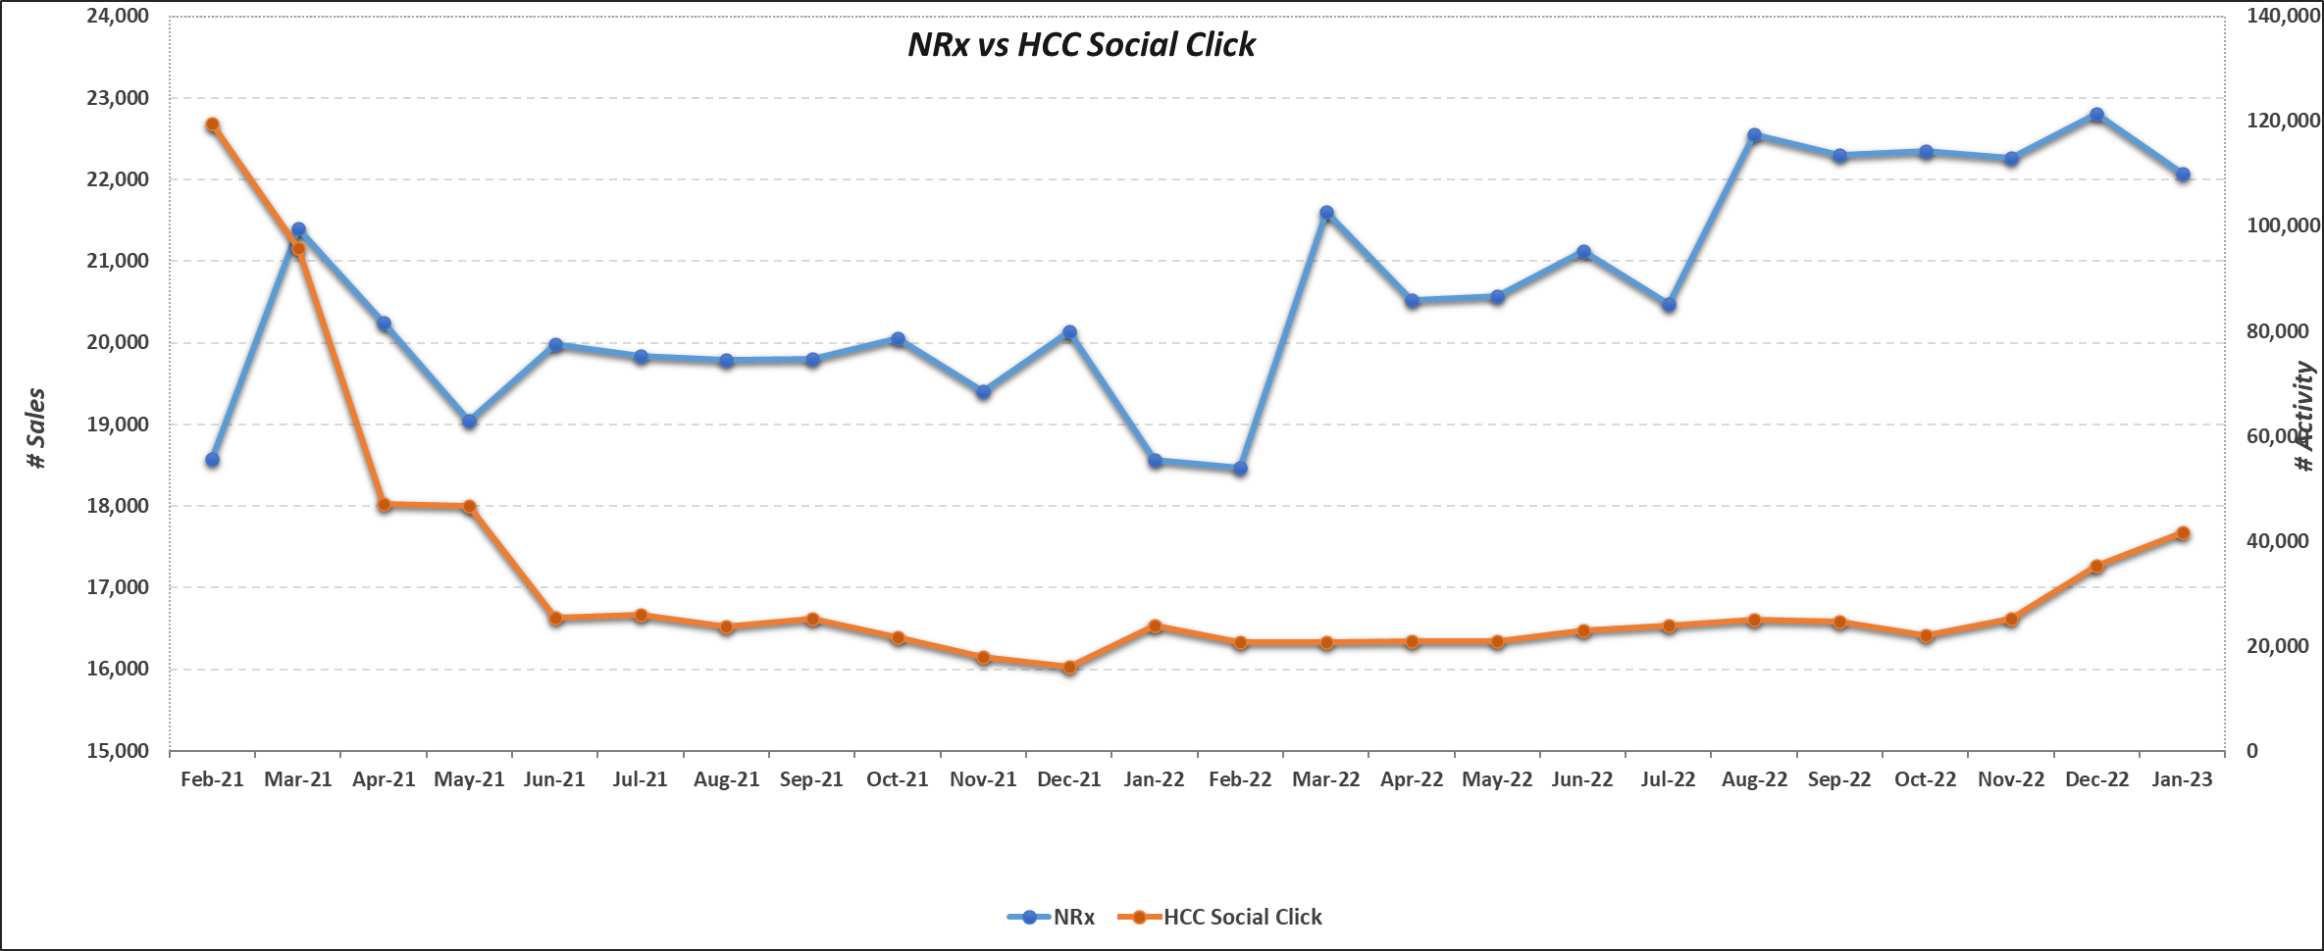
Explore Trends – HCC Social Clicks

Slide 11
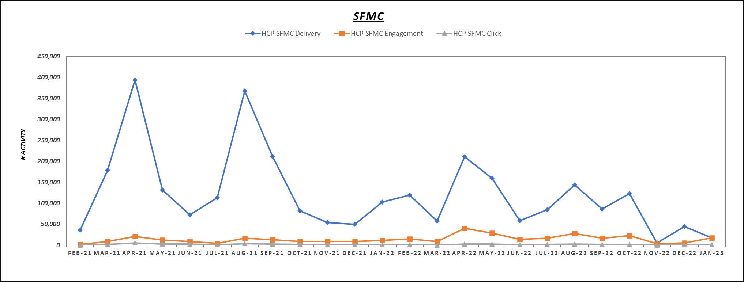
Explore Trends – HQ Email (SFMC) – Delivery, Engagements, Clicks

Slide 12
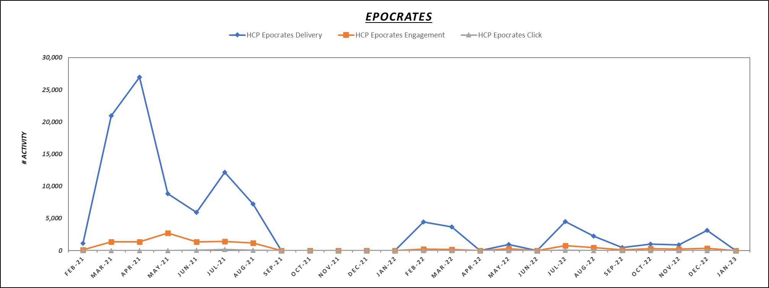
Explore Trends – HCP Epocrates - Pulsed

Slide 13
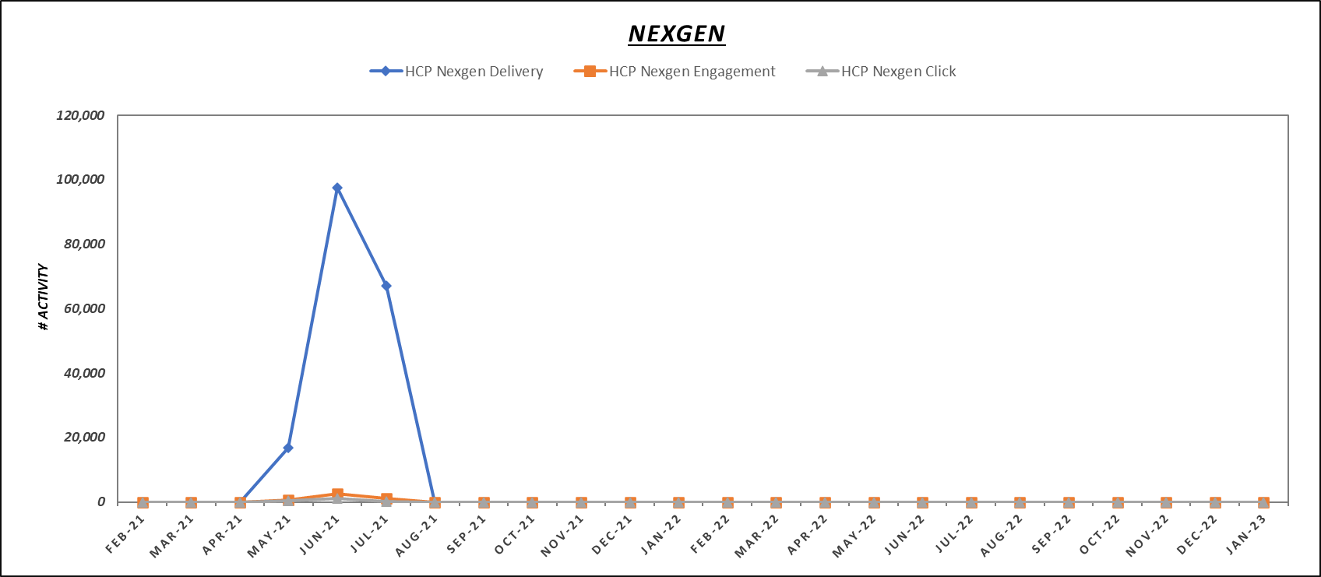
Explore Trends – HCP NexGen – Only Few Months of Activities

